Slide 1
Carl-bot
Group 8-30
Owen Moogk, Eidan Erlich, Shabd Gupta, Richard Wang

Slide 2
Contents
1
3
2
4
Need
Requirements
What is the robot designed to do?
Constraints that are most important to the final product.
Tasks
Working Schedule
Objectives that the robot can complete.
Our working plan.

Slide 3
Need
The need that the project will meet

Slide 4
Need
The need we want to address is to be able to move chess pieces by inputs entered by the player, to allow a player to play against another player, or allowing the player to play themselves to practice.
A solution to this need could be very helpful for people with disabilities and help them play a game of chess on the board.
IT’S COOL!

Slide 5
Tasks
Tasks that the robot will perform.

Slide 6
Tasks
Movement
Moving the claw along a gantry to access all locations on a board
Ideally using a 3D printer type setup (with two axis)
Claw Actuation
To pick up and move pieces
Opening and closing
File I/O
To import board states and output moves
To read previous games played
To output the history of a game

Slide 7
Tasks (continued)
Button Inputs
Be able to read from the user, and interpret intended moves
Other
How does the robot start?
Pressing the center button, will initiate the calibration process then prompt the user for inputs
What does it do while running?
Play chess! (make moves, read from the user / read from a file)
Shutdown Procedure?
A specific sequence of button presses on the display (haven’t decided yet, we have to determine how user input works first)

Slide 8
Requirements & Constraints
The need that the project will meet.

Slide 9
Requirements
To track the location of all the pieces on the board
To locate and pick up the selected piece

Slide 10
Motors and Inputs
()
()
()
()
Axial movement
Axial zeroing
2 motors for axial movement
Touch sensors will be used to zero the carriage after each movement
Claw movement
EV3 Brick buttons
Tetrix integration for claw actuation
EV3 buttons will be used for user input
()
Motor Encoder
()
File I/O
Measure and control movement
Read game states and output game moves

Slide 11
Constraints
Limited to specific pre-determined movements
Only play with specific sized chess board and pieces

Slide 12
Measuring Sucess
Success
Deadlines
Use of all inputs
High precision

Slide 13
Timeline
Projected Timeline

Slide 14
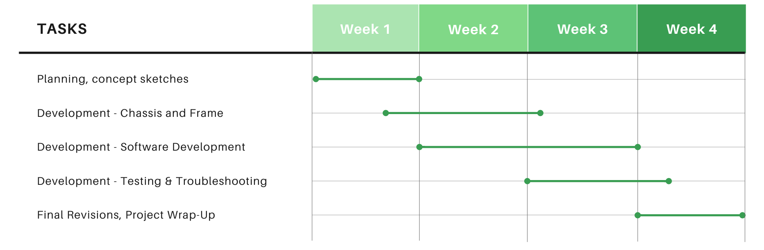
Timeline

Slide 15
Timeline – Key Milestones
Week 1
Complete concept sketches and planning
Finish building frame and chassis
Week 2
Chassis can move to any square on the board
Claw can pick up pieces and move them to any square
Week 3
Game replay working
Challenges system working
Week 4
All functions working
Finish final report

Slide 16
Our Questions
Work time
How much “In-class” time are we allocated? If any.
Code Collaboration
Do you have any software recommendations to collaborte on code?
Checkpoints
When should we put major checkpoints to ensure we will reach the deadline?

Slide 17
Thanks
Questions?

